Slide 1
MODULE 5. Management and Organizational Module
Migrants’ Integration through Culinary Arts
Cοοking Cultures
Erasmus + Programme [2019-1-KA204-074418]

Slide 2
PRIORITY FOR CULINARY SECTOR POSITIONS
There are many professions in the culinary sector. We have gathered some of these professions under 4 groups, based on the jobs of the people who participated in the “Cooking Cultures” surveys. These profession groups and the professions in them are as follows and are indicative:
1. Chef and Cooking Professionals: Chef, Assistant chef, Meat processor, Gastronomy Specialist, Confectioner, Baker, Pastry Chef, Culinary Art Technician, Boutique chocolatier and some local chefs (Pizzeria Chef, Kebap chef (Kebapçı) etc.)
2. Kitchen Industry Managers / Experts: Restaurant Specialist, Kitchen manager, Catering Company Manager, Dietician, Food Engineer, Food Technology Technician
3. Customer Services: Bar attendant, Service attendant, Service manager, Supplier, Courier, Waiter, Chief waiter, Komi, Cashier/Phone customer service
4.Cleaning staff/Expert: Scullery attendant, Dishwasher, Hygiene Staff, Sanitation Staff

Slide 3
PRIORITY FOR CULINARY SECTOR POSITIONS
Not all modules (training courses) we create are a priority for all of these professions. This grouping is made to explain the priorities of the trainings given according to the professions at national and international level. Three types of prioritization systems have been stated. These priorities and meanings are as follows;
HIGH PRIORITY
This module is a high priority for this profession group. This professional group should definitely receive this training.
MEDIUM PRIORITY
This module is of medium priority for this profession group. This professional group is recommended to take this module.
LOW PRIORITY
This module is of low priority for this profession group. It is not necessary for the professional group to receive this module.

Slide 4
PRIORITY FOR CULINARY SECTOR POSITIONS
So, is this module a priority for your profession? Please view priorities by profession groups below.
The priority of the “Introduction to Soft Skills for Employees in the Culinary Sector” module for professional groups are as follows:
HIGH PRIORITY
1.Chefs and Cooking Professionals
HIGH PRIORITY
2. Kitchen Industry Managers / Experts
HIGH PRIORITY
3. Customer Services
MEDIUM PRIORITY
4.Cleaning staff/Expert

Slide 5
AIMS & OBJECTIVES
The aim of this module is to introduce migrants and learners in Culinary Arts to the
definitions of;
“priority for culinary sector positions”,
“basics of food science”,
“food and beverage service”,
“strategies & techniques in the culinary sector”
“restaurant organization”
“development of business sense”.
Thus, with this module; who receive this training will have acquired
important managerial knowledge about the sector.
those

Slide 6
LEARNING OUTCOMES
Upon completion of this module, the learners will be able to:
LOut1: to learn the food science, F&B service basics
LOut2: to gain the management strategies for culinary arts
LOut3: to apply the professional approach at the business life.

Slide 7
KEYWORDS
Management
Organization
Food and Beverage Service
Culinary Business
Food Science

Slide 8
TABLE OF CONTENTS
Unit 1. Introduction: Basics of Food Science
1.1. Introduction
1.2. Food Chemistry
Unit 2. Food and Beverage Service
2.1. Learning Outcomes
2.2. Service Rules
Unit 3. Management: Strategies and Techniques in the Culinary Sector
3.1. Positions and Duties
Unit 4. Restaurant Organization
4.1. Organizational Issues
Unit 5. How to Develop Business Sense
5.1. Basic Introduction to Business Sense
5.2. Items that makes it Successful

Slide 9
UNIT 1: Introduction, Basics of Food Science

Slide 10
1.1. Introduction
Food science is a branch of science that reveals the relationships between food chemistry and microbiology and nutrition issues and examines food research. It collaborates with engineering and health sciences. It defines the nature of food, the causes of spoilage, the principles underpinning food processing, and a branch used to improve food for the consumer.
Food technology is the science that decides the processes that should be applied to foods in the light of food science. Engineers, chemists, hygienists, quality analysts, packers, biochemists act together to develop processes.

Slide 11
Classification of foods:
- vegetable-animal, - processed-unprocessed, - packaged-unpackaged, - natural-synthetic, - liquid-solid-semi-solid, - foods-drinks, - cereals-vegetables-fruit-meat, - milk and dairy products-eggs-bee products, - sea products.

Slide 12
2.2. Food Chemistry - Nutrients are naturally occurring chemical substances found in food. There are six categories of nutrients:
proteins,
lipids,
carbohydrates,
vitamins,
minerals,
water.
The chemistry of these nutrients influences the characteristics of our food.
Proteins, fats, and carbohydrates in food provide the energy our bodies need to
function.

Slide 13
2.2. Food Chemistry - After reading this unit, you should be able to:
• know constituents of food and properties, • explain chemistry of food and nutrition, • describe food spoilage and its effect, • discuss recent advances in food science and food evaluation.

Slide 14
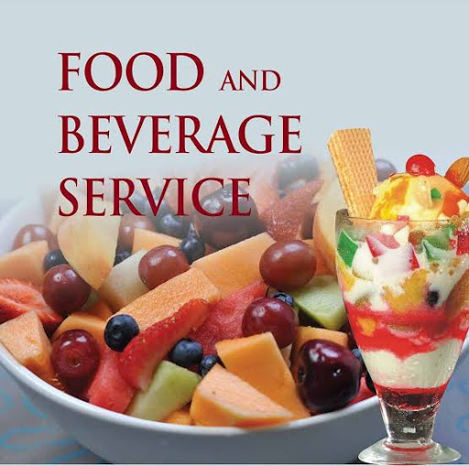
UNIT 2: Food and Beverage Service

Slide 15
The role of this Unit
The aim of this part is to provide the learners with a suitable learning
environment and the resources they need to complete the practical and theoretical aspects of the qualification.
After this course, successful participants will have the skills needed to perform their duties as a member of the F&B service team. They will be in a position to provide table service in an effective, efficient and organised manner, to understand the importance of carrying out the tasks in such a way that customer needs are the priority and to use service methods consistent with a five star level using internationally accepted standards.

Slide 16
Objectives of this Unit
*Explain the necessity of perfect grooming and etiquette *List the duties and tasks of F&B service staff *Demonstrate how to conduct briefings *Show how to set up and organise a restaurant and mise en place *Review all stages of a sequence of service *Demonstrate serving all food and beverage items *Focus on selling items and increasing revenue *Instruct staff on the correct methods of leadership in F&B *Practice service recovery and dealing with complaints

Slide 17
2.1. Learning Outcomes
Classifies the food and beverage organizations,
Distinguishes the phases of management process in food and beverage organizations,
Summarize the menu design,
To identify the purchasing process,
Explain the storing process,
Give examples from the international food and beverage concepts,
Explain the importance and purposes of revenue control,
Discuss the main stream trends,

Slide 18
2.1. Definitions
"Food" are products that can be eaten raw or cooked and are not harmful to the human body.
"Beverage” is a liquid to consume, usually excluding water; a drink. This may include tea, coffee, liquor, beer, milk, juice, or soft drinks.
Food and Beverage Service is a subject or study that educates students on how to serve customers well as a profession.

Slide 19
2.1. Definitions
Food and Beverage Services can be broadly defined as the process of preparing, presenting and serving of food and beverages to the customers.
F&B Services can be of the following two types −
On Premise − Food is delivered where it is prepared. The customer visits the premise to avail the food service. The premises are kept well-equipped and well-finished to attract customers to avail F&B service.
For example, restaurants, pubs, etc.
Off Premise or Outdoor Catering − This kind of service includes partial cooking, preparation, and service at customer’s premises. It is provided away from the F&B Services provider’s base on the occasion of major events which call for a large number of customers.

Slide 20
2.1. Definitions
There are two broad types of F&B Services operations −
Commercial − In this case, F&B Services is the primary business. The most known commercial catering establishments are — hotels, all kinds of restaurants, lounges, cafeterias, pubs, clubs, and bars.
Non-Commercial − Non-commercial operations are secondary businesses in alliance with the main business. These F&B services mainly cater to their consumers with limited choice of food and beverages. These establishments often run under contracts. For example, food and beverage services provided at hospitals, hostels, and prisons.
In this tutorial, we mainly consider commercial food and beverage service sector. Let us first understand some common forms of F&B service.

Slide 21
2.1. Definitions
What is Catering?
Catering is the business of providing foods and beverage service to the people at a remote location. It is a part of food and beverage service sector. For example, arranging food services at a wedding location.
What is QSR?
These are the fast food outlets called Quick Service Restaurants where the food is prepared, purchased, and generally consumed quickly. They are run with convenience as a main factor. Branded outlets such as McDonalds and Nando’s are QSRs.
What is FSR?
They are fine dining, family, specialty, ethnic, or theme restaurants called Full Service Restaurants where the food and beverage menu is wide and the customer’s expectations are high. They are operated with customer satisfaction and experience as the key factors.

Slide 22
2.2. Service Rules
The services and products that may be offered are extremely diverse, the only conditions being the operations and policies of the participating property. Food and beverage service is part of the service oriented hospitality industry. It can be part of a large hotel or tourism business and can also be operated as an independent business.
Food and Beverage Services come only after preparing what is to be served. Most food and beverage service businesses operate in the following cycle:

Slide 23
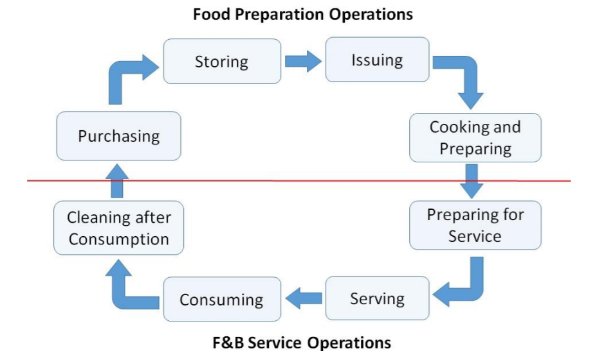
Resource: https://www.tutorialspoint.com/food_and_beverage_services/food_and_beverage_services_quick_guide.htm

Slide 24
F&B Sector
Although food and beverage service is a part of the service in general, it is still comprehensive. Catering is considered as a separate specialty that includes many activities, features and procedures. In this respect, it can be evaluated according to the following issues.
The cleaning of service places, learning the working system and times, knowing the service tools and their usage places and times, the materials used in the preparation of the meals, the ways of making and cooking, which group belongs to, when and how they are served, how the materials used into drinks, service temperatures, ways and times of service, learning about the tastes of guests about food and drink, knowing their social and psychological conditions and acting accordingly, organizing the menu, speaking well, learning and applying sales methods, etc. can be explained.

Slide 25
Food and Beverage Service Objectives
The food and beverage service is looked as a means of achieving satisfaction and making yourself feel comfortable in today’s world. The main objectives of this service are:
∙ To satisfy the following needs:
o Physiological: The need to taste different varieties of food.
o Economical: The need to get F&B Services at the invested cost.
o Social: The need to find friendly atmosphere.
o Psychological: The need to elevate self-esteem.
∙ To provide high quality food and beverages.
∙ To provide friendly and welcoming atmosphere.
∙ To provide professional, hygienic, and attentive service.
∙ To impart value for money.
∙ To retain the existing customers and to bring in new ones.

Slide 26
Food and beverage services sector contributes a great deal to the profits in hospitality industry. With the increase in importance of business meetings, a range of personal and social events, a large number of customers visit catering establishments frequently. The food and beverage professionals tirelessly work to intensify customers’ experience through their service.
The F&B Services providing businesses deliver food and beverages to their customers at a particular location (on-premise) such as hotel, restaurant, or at the customer’s intended premises (off-premise).

Slide 27
UNIT 3: Management: Strategies and Techniques in the Culinary Sector

Slide 28
3.1. Management Strategies in the Kitchen Sector
The world will continue to evolve over the coming years. New trends and insights will need to be taken account of, and innovative and creative projects may need to be supported.
We also need to monitor the effectiveness of the strategy and the sustainability of any particular initiatives. Therefore, a review should be undertaken in 2020 to identify what is working best, refresh the strategy as required, and make necessary changes.

Slide 29
3.1. Management Strategies in the Kitchen Sector
However, to achieve overall success, all stakeholders have to play their part in delivering what is needed. Our posture is one of proactive collaboration in areas of high relevance with our industry but requires a renewed focus on cross collaborative initiatives to deliver outcomes of scale.

Slide 30
3.1. Management Strategies in the Kitchen Sector
The culinary industry faces enormous challenges in ensuring food safety and security while respecting the environmental and social concerns of society in a world with increasing population, increasing urbanization, increasing requirements for higher-value diets, but with availability constraints and decreases.
These difficulties depend on resources such as land, water or energy; It will depend on strategic approaches that can change the existing infrastructure, organization, production, distribution or retail, as well as the industry's offering of products to the consumer.

Slide 31
3.1. Innovation Strategies in the Kitchen Sector
The diversity and creativity of small and medium-sized businesses can play an important role in making innovations, especially if they are supported by experts and appropriate network organizations that facilitate knowledge exchange and interaction with research.
However, the transition from inventions to innovation depends on the appropriateness of driving forces and needs, and the availability of facilitators that facilitate the large-scale acquisition of inventions by the industry.

Slide 32
A SWOT Analysis
A SWOT analysis must always be included in your restaurant business plan as it helps you analyze your current situation, and prepares you for what lies ahead. You should use your strengths to take advantage of the opportunities at hand and work to eliminate the weaknesses of your restaurant to avoid potential threats.
The food and beverage industry is the sub-category of the Hospitality industry such as hotels and restaurants, where they serve their guests with a variety of food and drinks along with other services. When we talk about the food and beverage industry, then it relies on two major parts; production and distribution. However, production starts with the farmers and fields, then transported to industries. After the process, you’ll get the distribution of your orders along with other stakeholders.
Food and beverage is a very competitive industry with a plethora of competitors in the market. The right SWOT analysis would help you to make good strategic decisions. Like how to identifies core strengths and weaknesses of the company, and to minimize threats and take advantage of the opportunities.
It’s better to coordinate with all the departments while conducting a swot analysis, because it would provide you an insight from the various perspectives.

Slide 33
A SWOT Analysis
A SWOT Analysis is primarily identifying the Strengths (S), Weaknesses (W), Opportunities (O), and the Threats (T) of the restaurant that you can use to plan your business strategies.
The culinary industry, especially small and medium-sized businesses
(SMEs), is facing increasingly complex challenges, more regulation, and fierce local
and global competition.
Swot is an exercise to determine your restaurant’s;
Strengths,
Weaknesses,
Opportunities,
Threats (hence the acronym SWOT).
When performing a SWOT, you should look at both internal and external factors
to get the best picture of the current state of your restaurant.

Slide 34
Among your strengths may be the popularity of your food, your marketing strategy, and your managers’ years of experience. Use these to propel your business forward, constantly maintaining (or improving) what your company is already good at. This is your angle that can help edge you ahead of your competition.
Weaknesses may begin with an inability to extract, analyze and use the data at your fingertips. They may also include the inability to stay on top of industry trends, an issue with keeping track of inventory, or constant turnover of wait staff. Retention is tough in the restaurant business, and paying a premium for good, experienced employees may pinch the bottom line but result in significant long-term returns by retaining customers.

Slide 35
Opportunities can include business visibility through online reviews, the chance to grow your social presence, growing your online presence, and leveraging your loyal customers through word-of-mouth and marketing campaigns.
Threats to your restaurant may include nearby competitors, an inconsistent social media presence, negative reviews, or poor staff management. You should pay special attention to these threats because they are the most risky factors that can tour your success sour.

Slide 36
After putting together your SWOT Analysis, begin to create an action plan for business improvement. Determine which challenges you’ll tackle first and map out a timeline with goals and checkpoints. Without having a solid plan in place, you may push your responsibilities to the side in order to solely focus on the here and now instead of the future.

Slide 37
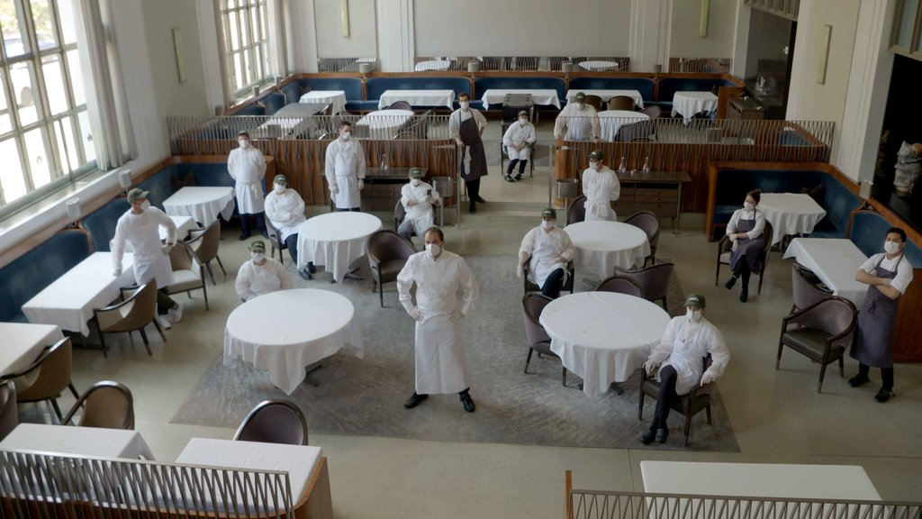
UNIT 4: Restaurant Organization

Slide 38
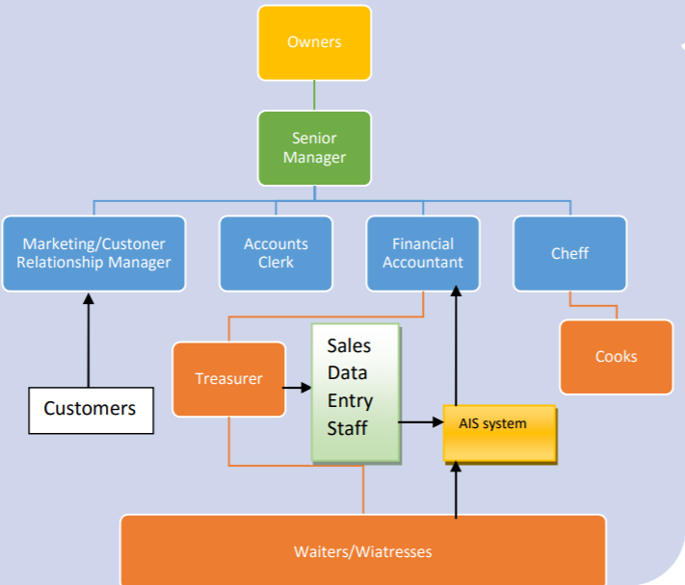
Source: Godfried Asamoah, 2019

Slide 39
Restaurants have very specific staffing needs, and their organizational structure must be in line with those needs to function well.
The size of the restaurant usually determines the ultimate structure; staffers often take on more than one role in smaller establishments, but restaurants typically have the same basic framework, regardless of their size.
The structure is designed to implement a system of responsibility and accountability, with a clear chain of command.
The organizational structure of a restaurant can vary somewhat, depending on the needs of a particular location, though the general structure begins with the owner. A restaurant’s owner has ultimate say in the management and business of a restaurant, and he or she may act as the manager or hire a manager to handle daily tasks. This manager is typically a department manager or head, such as an executive chef or head chef, a head waiter or waitress, or a house manager. These different managers are all part of the organizational structure of a restaurant and have individual chefs, waiters and waitresses, hosts and hostesses, and other staff “under” them.

Slide 40
A restaurant owner is at the top of the organizational structure of a restaurant. He or she is the person who actually owns the restaurant and is ultimately responsible for everything that happens within it, though various types of authority and responsibility are often delegated to other employees. The overall structure of a restaurant can typically be broken down into two major categories, which are the kitchen and the “front of house” or dining room.
In a restaurant, the kitchen is where food is prepared by a group of chefs and cooks. A kitchen manager can be hired by a restaurant owner to run the kitchen, though this responsibility can also fall to a head or executive chef, who is responsible for overseeing all food coming out of the kitchen as well as the organization and preparation of that food. The head chef also cooks food, but is assisted by one or more other chefs and cooks who prepare and plate food.
If the head chef is the owner of a restaurant, then he or she usually hires an operations manager, general manager, or dining room manager to handle the other half of the restaurant. The exact responsibilities of this second manager, who may be the owner in other situations, can vary quite a bit. In general, it is up to him or her to ensure diners at a restaurant are served properly and have an enjoyable experience. Chefs cannot typically deal with issues in the dining room, also called the “front of house” while the kitchen is the “back,” so servers and other people in the dining room handle such issues.

Slide 41
The waiters and waitresses within the dining room usually answer to the dining room or general manager. A head waiter or waitress can also be utilized to act as a liaison between various servers and managers, and this is most common in large restaurants. The rest of the organizational structure of a restaurant is made up of servers, dishwashers, and other employees who typically make up the lowest level of authority within a restaurant. A host or hostess can also be utilized to greet diners and organize seating rotations for servers, though a dining room manager or owner may take on this responsibility.

Slide 42
4.1. Organizational Issues
Operations carried out in the food and beverage department; it consists of a wide variety of highly complex and at the same time responsible actions. Staff working in the food and beverage department are constantly monitored by the guests. For this reason, the working staff should be knowledgeable, skilled and meticulous in all matters related to food and beverage.
In order for a successful and flawless service to be realized, preparation should be done very well in restaurants and bars, the maintenance and cleaning of the tools and materials used in the service should be done perfectly before the service starts. Spare materials such as plates, glasses, forks, spoons, knives and napkins used during service; It should be ensured that ketchup, mayonnaise, mustard, olive oil, vinegar, lemon and various sauces are available completely and perfectly.

Slide 43
4.1. Organizational Issues
Planning the food and beverage service, collecting similar works in one section; determining the duties, authorities and responsibilities and limits of the people who will carry out the works, ensuring the work flow; Operations such as fulfilling the coordination between individuals and departments can be expressed as organizing the food and beverage department within itself.
On the other hand, a successful food and beverage service, which requires division of labor and specialization, can be achieved by ranking (ranking) the staff within themselves. Thus, service and bar personnel receive a title according to their knowledge and skills, their job and their professional education. All personnel working in the food and beverage department must fulfill their duties in place and on time so that a quality food and beverage service is provided by combining the services carried out by different departments.

Slide 44
4.1. Organizational Issues
A restaurant organizational chart will show employees in an organized chain of command. A general restaurant organizational chart looks like this: The business belongs to the owners, and they will make all major restaurant decisions.
They hire a general manager and an executive chef to control the day-to-day operations.
A front-of-house manager stays on the floor and keeps communication directly with the general manager, while shift leaders are chosen by the front-of-house managers for their leadership qualities and experience .

Slide 45
4.1. Organizational Issues
Corporate or local owners are ultimately in control of the restaurant. They are the ones who stand to make or lose the most due to the success or failure of the restaurant.
The owners usually are responsible for hiring the management team for a restaurant and may also choose the executive chef. There is an expectation that the ownership's policy information will be passed all the way down the chain of restaurant command.

Slide 46
4.1. Organizational Issues
Food and beverage department; In large-scale and five-star hotels, it consists of sub-managers such as restaurant manager, bar manager, banquet manager, kitchen chef (Executive Chef), dishwasher chef (Chief Steward) and cost control manager (Cost Control Manager) under the management of food and beverage management.
According to the predetermined menu planning in all these units; Transactions such as purchasing, receiving, storing, preparing, cooking and serving food and beverages are carried out.

Slide 47
4.1. Organizational Issues
Food and beverage department; In large-scale and five-star hotels, it consists of sub-managers such as restaurant manager, bar manager, banquet manager, kitchen chef (Excutive Chef), dishwasher chef (Chief Steward) and cost control manager (Cost Control Manager) under the management of food and beverage management.
According to the predetermined menu planning in all these units; Transactions such as purchasing, receiving, storing, preparing, cooking and serving food and beverages are carried out.

Slide 48
4.1. Organizational Issues
Operations carried out in the food and beverage department; It consists of a wide variety of highly complex and at the same time responsible actions. Staff working in the food and beverage department are constantly monitored by the guests. For this reason, the working staff should be knowledgeable, skilled and meticulous in all matters related to food and beverage.
In order for a successful and flawless service to be realized, preparation should be done very well in restaurants and bars, the maintenance and cleaning of the tools and materials used in the service should be done perfectly before the service starts. Spare materials such as plates, glasses, forks, spoons, knives and napkins used during service; It should be ensured that ketchup, mayonnaise, mustard, olive oil, vinegar, lemon and various sauces are available completely and perfectly.

Slide 49
UNIT 5: How to Develop Business Sense

Slide 50
5.1. Basic Introduction to Business Sense
Developing a good sense of business is about developing an ever-evolving understanding of the ever-changing dynamics of the local, national and international business environment.
Good business sense often develops in business through hands-on experience and trial and error, but can also be developed through education, research, and guidance.

Slide 51
Seek Honest Feedback
Hands-on experience and trial and error are one of the most practical and effective ways to develop a good sense of business, especially if you're seeking criticism from other business professionals.
When making important decisions or implementing high-level projects, ask a reputable colleague to evaluate your performance by pointing out both your strengths and weaknesses. Use feedback to improve your approach and use past mistakes to get future success.

Slide 52
5.2. Items that makes it Successful
The fast-paced world of the culinary industry welcomes professionals who are skilled, passionate about the trade and innovative in their creations.
Below are some of the very essential qualities of culinary sector person that will help to achieve success in the trade.
Passion: Employees who want to be succesful, have to be passionate about food and cooking. They have to genuinely enjoy the whole process of procuring, preparing, cooking and serving food and have to be able to design menus too.
Stamina: An essential quality of a business sense is stamina. The commercial kitchen is a hard place to work; long hours on foot exposed to heat, grease, high pressure and odd working hours; employees need stamina to remain focused and consistently produce top quality food.
Leadership skills: It is the chef who is responsible for the kitchen. They have to be able to give direction to their team and maintain an amicable atmosphere in their kitchen. They need to guide, coach and monitor their juniors so that the operations run smoothly.

Slide 53
5.2. Items that makes it Successful
Creativity: It is taken for granted that a chef will be creative. It is this quality that actually brings in the customers. It is also what comes to aid when there maybe some ingredient missing and a great tasting dish needs to be produced.
Flexibility: No job in the kitchen should be beneath a chef. It is only a flexible chef who can ensure that his kitchen is running smoothly, pitching in wherever necessary be it at the range or the wash basin.
Organization: To run a well oiled kitchen the chef has to be organized. Every aspect of the job has to be planned out be it the proper utilization of staff, the traffic flow of the kitchen especially during rush hours, the kitchen layout and the food preparation or its plating.

Slide 54
5.2. Items that makes it Successful
Multitasking: The ability to multitask comes to great use in the life of a chef. They are overall in charge so from planning and designing menus to raw material procurement and inventory management to ensure that the right food goes to the right table, all the elements of a kitchen have to come together at the right time to result in seamless satisfactory service. It is the chef’s duty to keep tabs on all of it.
Commitment to quality: Every chef has to be committed to quality using only the freshest and best quality ingredients and the best techniques to produce tasty food of the highest grade.
Handle criticism: There is no guarantee that everybody will always love the food cooked by a chef. He will sometimes face criticism and he has to be able to handle it with equanimity, analyze the feedback and take appropriate action on it.

Slide 55
Synopsis
Food and beverage services sector contributes a great deal to the profits in hospitality industry. With the increase in importance of business meetings, a range of personal and social events, a large number of customers visit catering establishments frequently.
Food & Beverage (F&B) Management is a segment of the hospitality industry that focuses on operations in restaurants, hotels, resorts, catering companies, hospitals, hotels, and more. It includes the business side of food, like ordering and inventory, managing budgets, and planning and costing menus.

Slide 56
List of References
A Competitive EU Food and Drink Industry for Growth and Jobs Ambitions for 2025 Priorities and policy recommendations fooddrinkeurope.eu/uploads/publications_documents/Competitive_food_industry_growth_jobs_report.pdf
[John S. I. Ingram, Hugh L. Wright, William J. Sutherland, Priority research questions for the UK food system, Food Security, volume 5, pages 617–636(2013), link.springer.com/article/10.1007/s12571-013-0294-4#Tab1
ANADOLU UNIVERSITY PUBLICATION NO: 2540, OPEN EDUCATION FACULTY PUBLICATION NO: 1511, FOOD-BEVERAGE SERVICES, 2012
Erkan Denk, FOOD AND BEVERAGE SERVICE 1, TOURISM and HOTEL MANAGEMENT PUBLICATIONS, ATATÜRK UNIVERSITY, 2019
Godfried Asamoah, 2019, DEVELOPING AN ACCOUNTING INFORMATION SYSTEM FOR A RESTAURANT AND UNDERSTANDING ITS POTENTIAL IMPACT ON THE BUSINESS

Slide 57
Online Additional Materials & Resources
Foodie Traveller – The Guardian, www.theguardian.com/travel/series/the-foodie-traveller
GUIDE TO CULINARY CAREER PATHS, accreditedschoolsonline.org/culinary-schools/careers/
HOW TECHNOLOGY IS TRANSFORMING THE FOOD INDUSTRY, https://easternpeak.com/blog/how-technology-is-transforming-the-food-industry
Food and Beverage Industry: Are You Digital Enough? https://hospitalityinsights.ehl.edu/food-and-beverage-industry-digitalization
Culinary Resume Examples with Skills, Objectives & 20+ Tips, https://zety.com/blog/culinary-resume-example
A List of Interview Questions for Chefs, https://www.thebalancecareers.com/chef-interview-questions-2061467

Slide 58
Online Additional Materials & Resources
Explore Industry Careers, National Restaurant Association, 2020, https://restaurant.org/restaurant-careers/job-titles
Understanding different types of job interviews, 2019, Career Thinker, https://www.careerthinker.com/interviewing/types-of-interview/
Block-1 Introduction to Food Science & Technology, Ignou The People’s University, 2017,
http://egyankosh.ac.in/handle/123456789/1091
Food and Beverage Services, 2016, https://www.tutorialspoint.com/food_and_beverage_services/food_and_beverage_services_tutorial.pdf
Food and Beverage (F&B) Service Multiple Choice, 2020, https://hoteltalk.app/t/70-food-and-beverage-f-b-service-multiple-choice-questions-and-answers/3577
Chef ACADEMY, Qualities of a chef
London, 2020,
https://www.chefacademyoflondon.com/en/blog/661-qualities-of-a-chef.html

Slide 59
Online Additional Materials & Resources
What Is the Typical Organizational Structure of a Restaurant?
G. Wiesen, Last Modified Date: February 09, 2021
www.delightedcooking.com/what-is-the-typical-organizational-structure-of-a-restaurant.htm

Slide 60
“Funded by the Erasmus+ Programme of the European Union. However, European Commission and Turkish National Agency cannot be held responsi­ble for any use which may be made of the information contained therein”
Erasmus + Programme [2019-1-KA204-074418]

Slide 61
Thank you for your attention!
“This document reflects the views only of the authors, and the European Union cannot be held responsible for any use which may be made of the information contained therein.”

